Slide 1

COSI 104a Introduction to machine learning
Chapter 15 – DBSCAN
 | Instructor: Dr. Hongfu Liu Email: hongfuliu@brandeis.edu
Main source: https://www-users.cs.umn.edu/~kumar001/dmbook/index.php

Slide 2
DBSCAN
DBSCAN is a density-based algorithm.
Density = number of points within a specified radius (Eps)
A point is a core point if it has at least a specified number of points (MinPts) within Eps
These are points that are at the interior of a cluster
Counts the point itself
A border point is not a core point, but is in the neighborhood of a core point
A noise point is any point that is not a core point or a border point
Resistant to Noise
handle clusters of different shapes and sizes

Slide 3
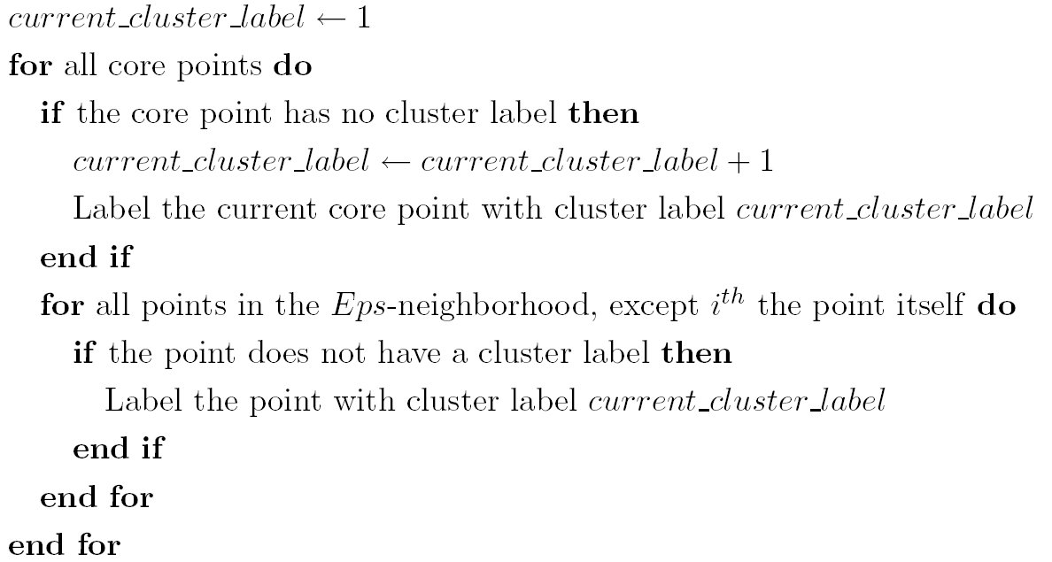
DBSCAN
Algorithm
Eliminate noise points
Perform clustering on the remaining points

Slide 4
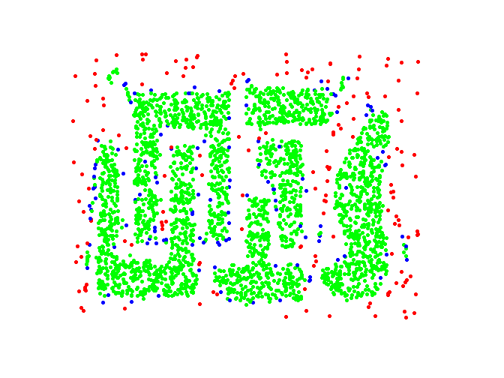
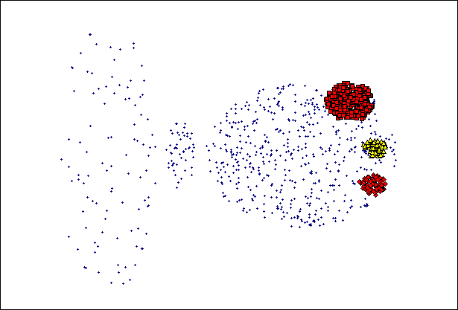
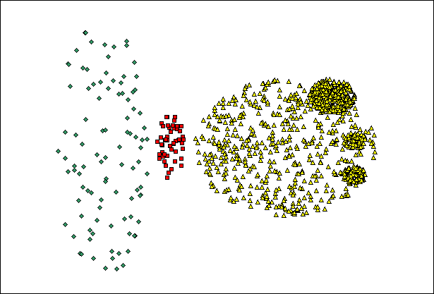
DBSCAN
(MinPts=4, Eps=9.75).
Point types: core, border and noise
(MinPts=4, Eps=9.92)

Slide 5
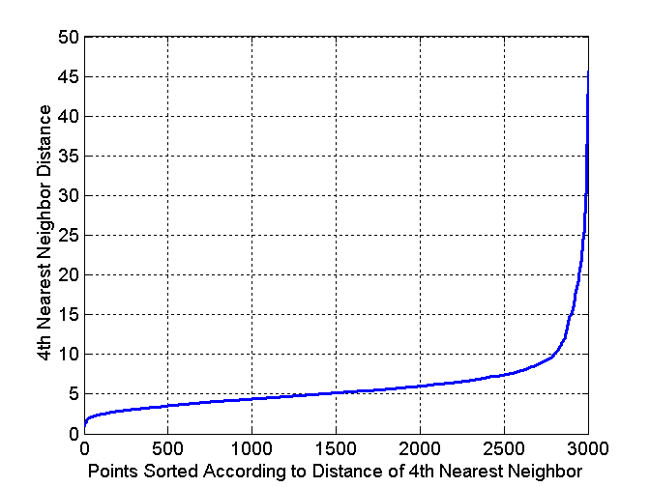
DBSCAN
Determining EPS and MinPts
Idea is that for points in a cluster, their kth nearest neighbors are at roughly the same distance
Noise points have the kth nearest neighbor at farther distance
So, plot sorted distance of every point to its kth nearest neighbor
Default setting?
Problem on density?

Slide 6


